Slide 1
Financial Forecasting Using Power BI
Pabba Sathvika

Slide 2
Financial Forecasting
Financial forecasting is the process of predicting a company’s future financial performance based on historical data, current trends, and expected future conditions. It helps businesses make smart decisions by estimating things like sales, quantity,profits etc

Slide 3
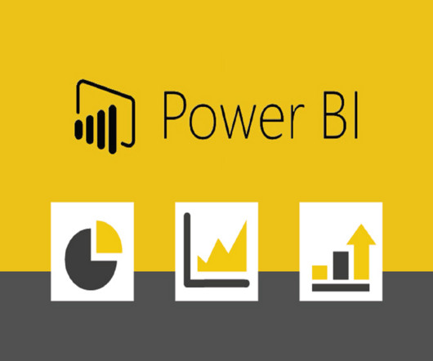
What is Power BI?
Power BI is a business analytics tool developed by Microsoft that helps users visualize data, derive insights, and make data-driven decisions.

Slide 4
Power BI Features
Developed by Microsoft for data visualization and analysis.
Connects to multiple data sources (Excel, databases, cloud services).
Transforms raw data into clean, usable formats.
Creates interactive reports and dashboards to monitor metrics.
Supports custom calculations using the DAX formula language.
Includes AI tools for deeper insights (like natural language queries).
Allows sharing reports through the Power BI Service (cloud).
Mobile apps for on-the-go access to reports and dashboards.

Slide 5
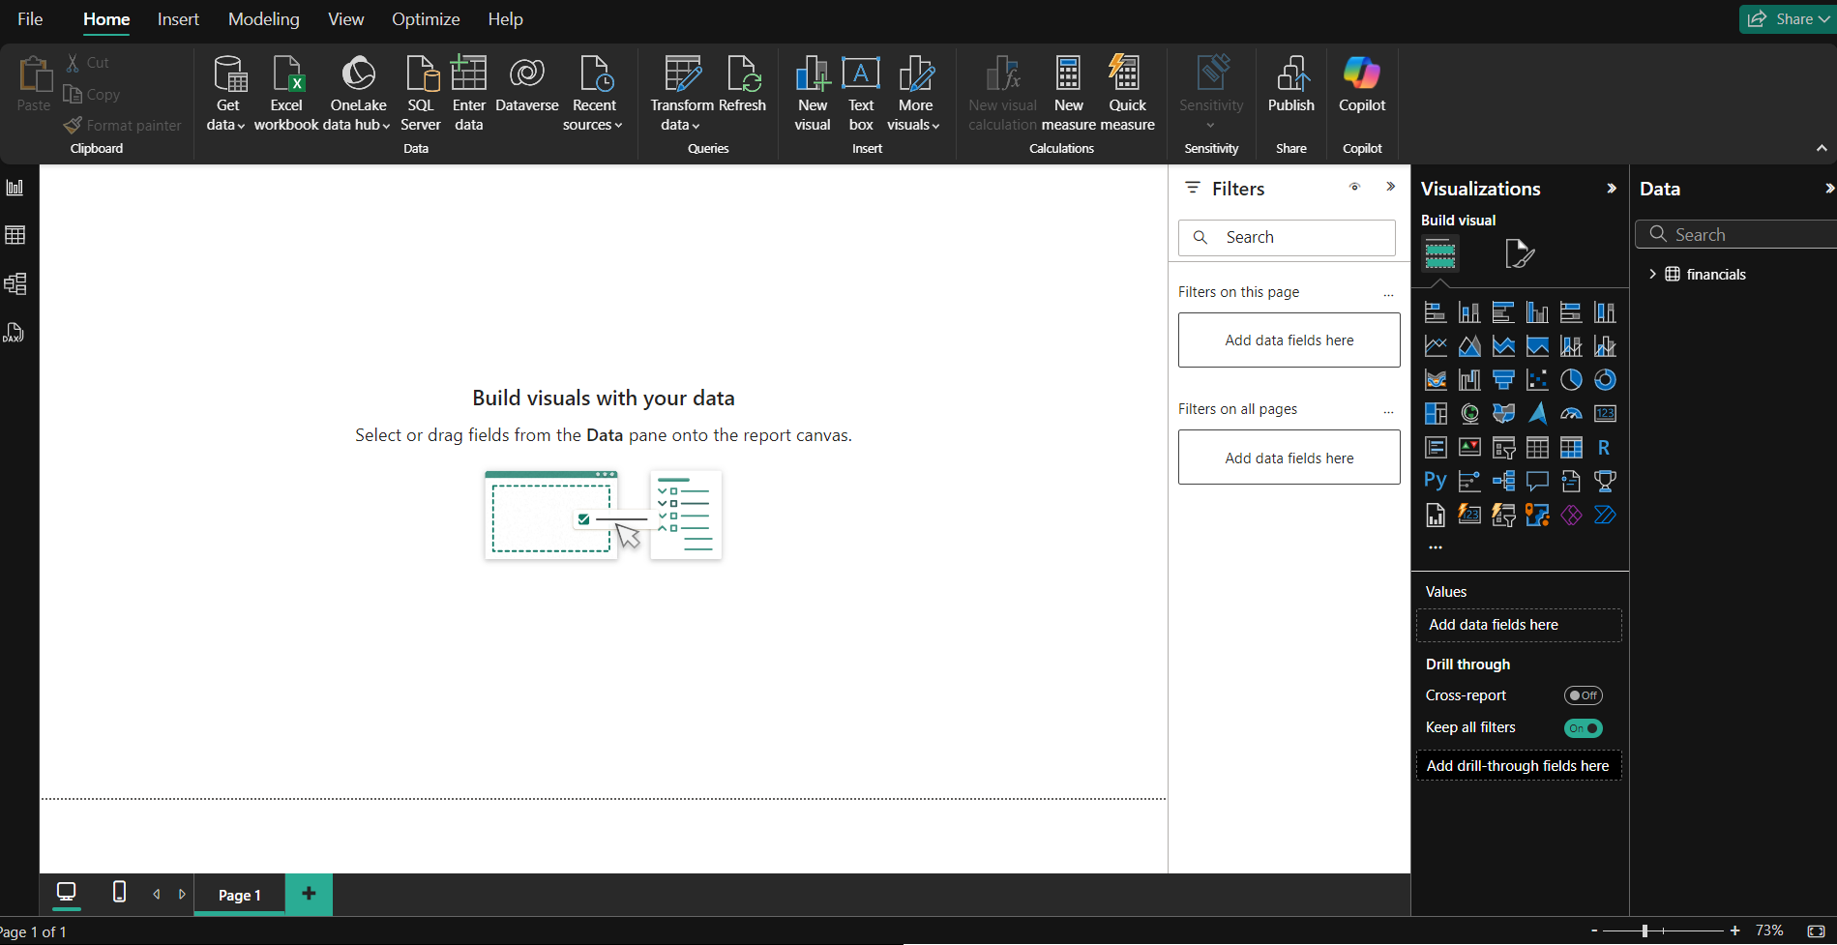
key features of power BI Desktop app
1. Data Connectivity
2. Data Transformation and Cleaning
3. Data Modeling
4. Visualizations
5. Custom Visuals
6. Drag-and-Drop Interface
7. Slicers and Filters
8. Advanced Analytics
9. Report Sharing and Collaboration
10. Query Folding
11. Bookmarks and Drillthrough
12. Performance Optimization
13. Scheduled Refresh

Slide 6
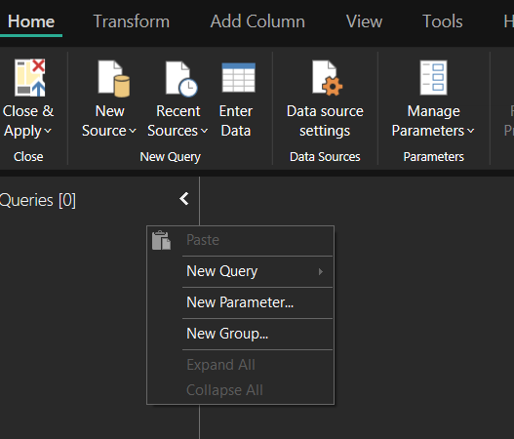
Ways to Load Data into Power BI
Open Power BI Desktop → Click "Get Data" → Choose file type (e.g., Excel, CSV, JSON) → Browse and select the file → Click "Open" → Select sheet/table (if applicable) → Click "Load" or "Transform Data".
Power Query Editor → Click "New Source" → Choose data source type (e.g., Excel, CSV, SQL) → Browse and select file/data source → Load data into Power Query Editor
Power Query Editor → Right-click in the Queries pane → Select "New Query" → Choose data source type (e.g., Excel, CSV, SQL) → Browse and select file/data source → Load data into Power Query Editor → Click "Close & Load" to load the data into Power BI.

Slide 7
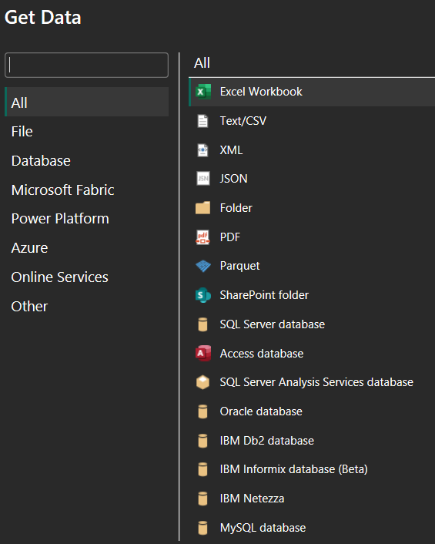
Data Sources Supported By Power BI
1. Excel Files
2. CSV Files
3. Text Files
4. JSON Files
5. XML Files
6. PDF Files
7. Parquet Files
8. SharePoint Folder
9. Folder
10. Database Files
11. Power BI Datasets

Slide 8
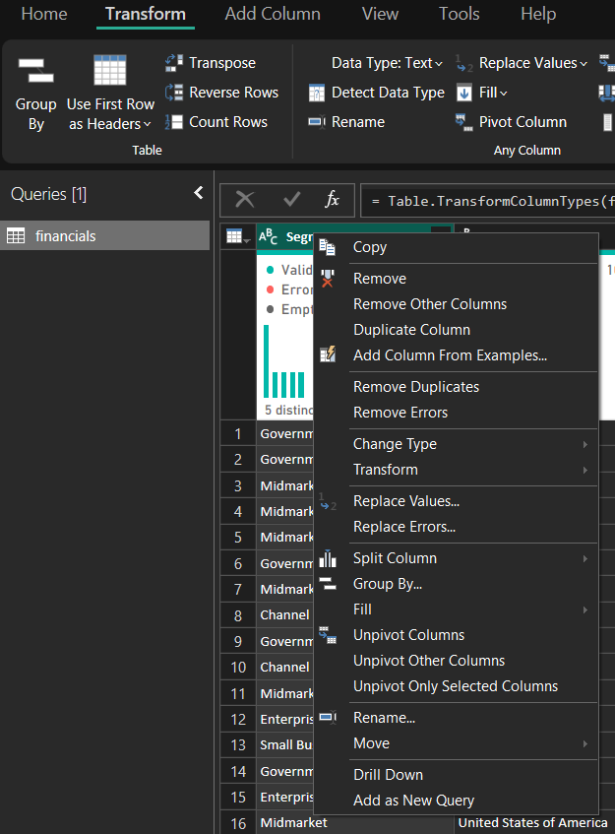
Transforming Data Operations in Power Query Editor
Removing Unwanted Columns
Filtering Rows
Changing Data Types
Splitting Columns
Merging Columns
Grouping Data
Replacing Values
Removing Duplicates records.
Adding Custom Columns
Renaming Columns
Using the Ribbon Menu
Right-Clicking on Columns

Slide 9
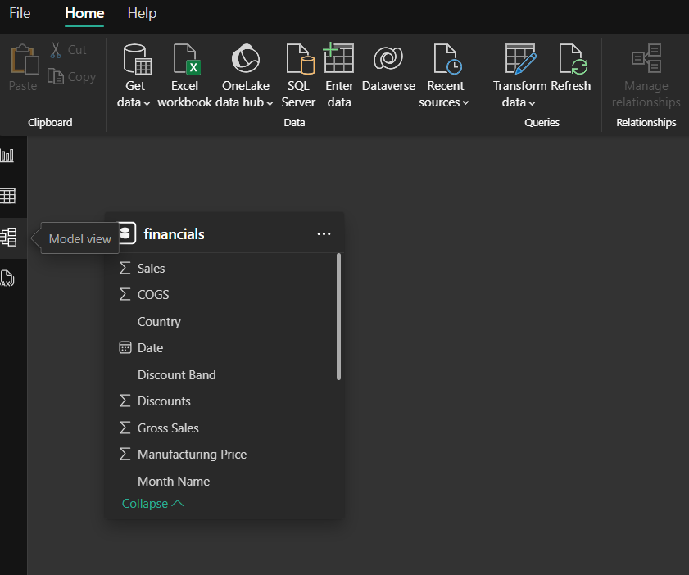
Data Modeling
Relationship Types:
One-To-Many
Many-To-Many
One-To-One
Model View → Drag and drop fields between tables → Create relationship
Modeling Tab → Click on Manage Relationships → Add/Edit/Delete relationships

Slide 10
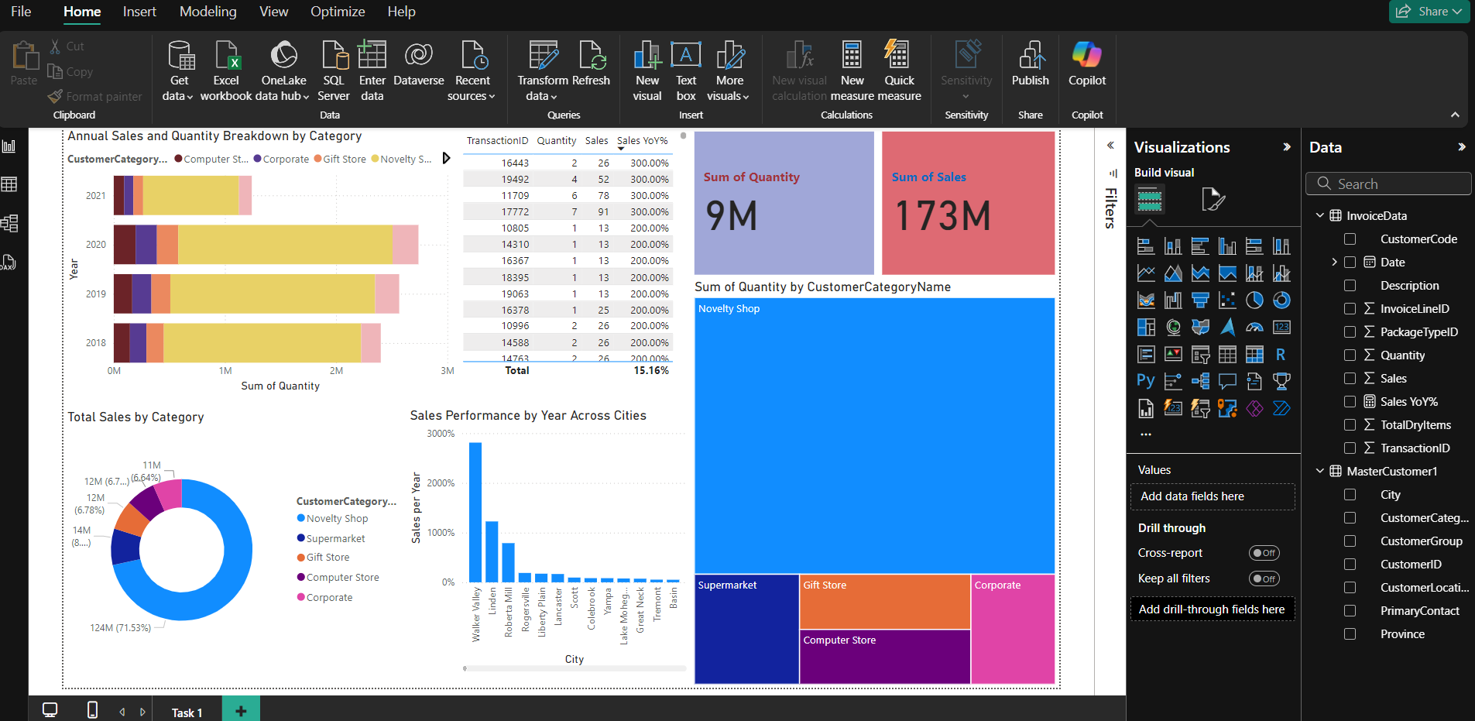
Designing Reports
Create interactive visuals to display data.
Use charts, tables, and graphs to present information.
Add filters and slicers for easy data exploration.
Design layouts for clear and intuitive reports.
Focus on highlighting key metrics and insights.
Enable drill-down options for detailed analysis.
Ensure reports are user-friendly and engaging.

Slide 11
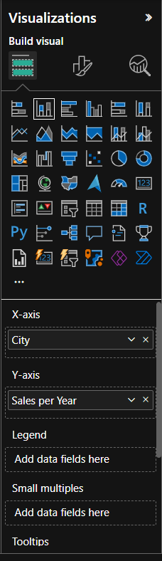
Visualizations in Power BI
Bar and Column Charts → Compare values across categories
Line Charts → Show trends over time
Pie and Donut Charts → Display proportions of a whole
Area Charts → Highlight trends with filled areas under lines
Scatter and Bubble Charts→ Show relationships between variables
Tables and Matrices→ Display detailed data in tabular form
Maps (Filled and Shape Maps)→ Visualize geographic data
Tree Maps → Show hierarchical data with nested rectangles
KPI (Key Performance Indicator) → Highlight key metrics against targets
Slicers → Provide filters for interactive reports
Cards (Single and Multi-row) → Display key figures or summary data

Slide 12
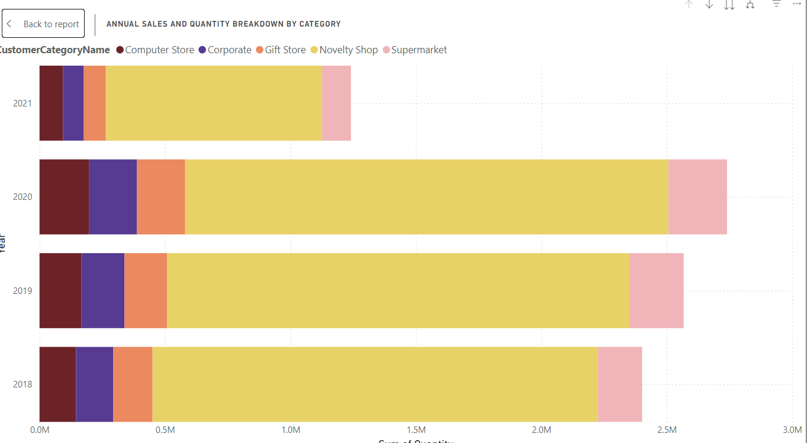
Column Chart

Slide 13
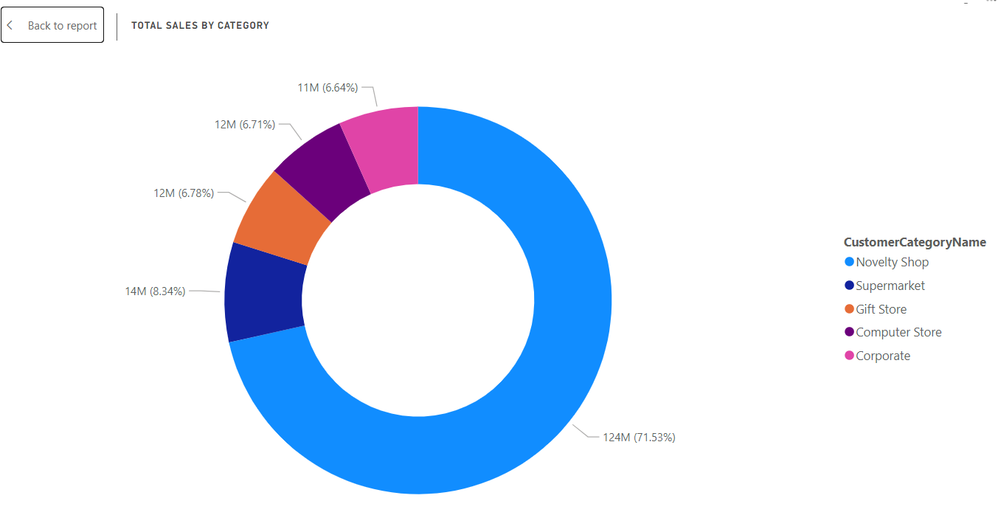
Donut Chart

Slide 14
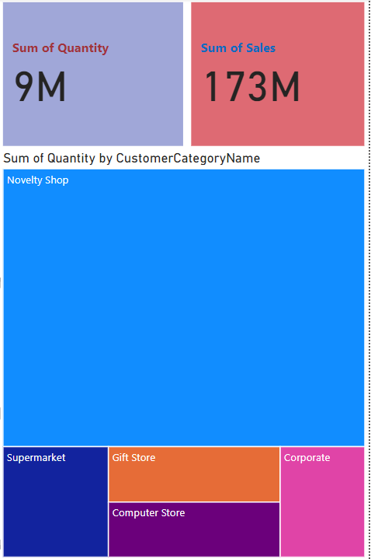
Cards And Tree Map

Slide 15
Thank You

